Slide 1
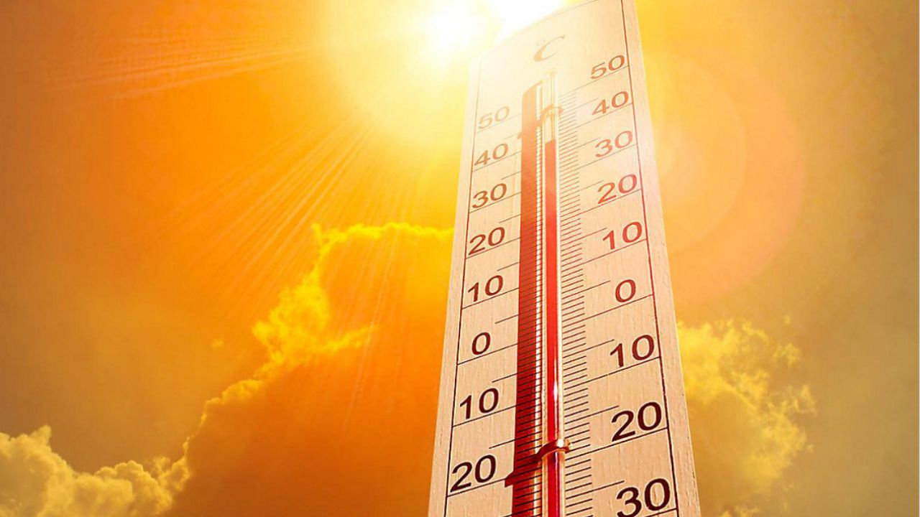
Temperature Variations
In Pakistan
<Your Name>
<Date>

Slide 2
Outline
Executive Summary
Mean Temperature Comparison of Different Areas
Mean Temperature of Pakistan Through the Years
Mean Temperature Comparison of Areas Through the Years
Key Findings and Conclusion

Slide 3
Executive Summary
An analysis was applied on the data regarding the Northern, North-Western and Western areas of Pakistan, more specifically in Balochistan, Khyber Pakhtun Khwa and Islamabad, with respect to their temperature (°C) throughout the years from 2015-2020. The goal of this project was to find any underlying patterns that exist inside this data, and during the analysis, multiple patterns were discovered which provided us with significant insights.
The visualizations of this data has been provided in the presentation going forward in the form of various charts and graphs for a better visual understanding

Slide 4
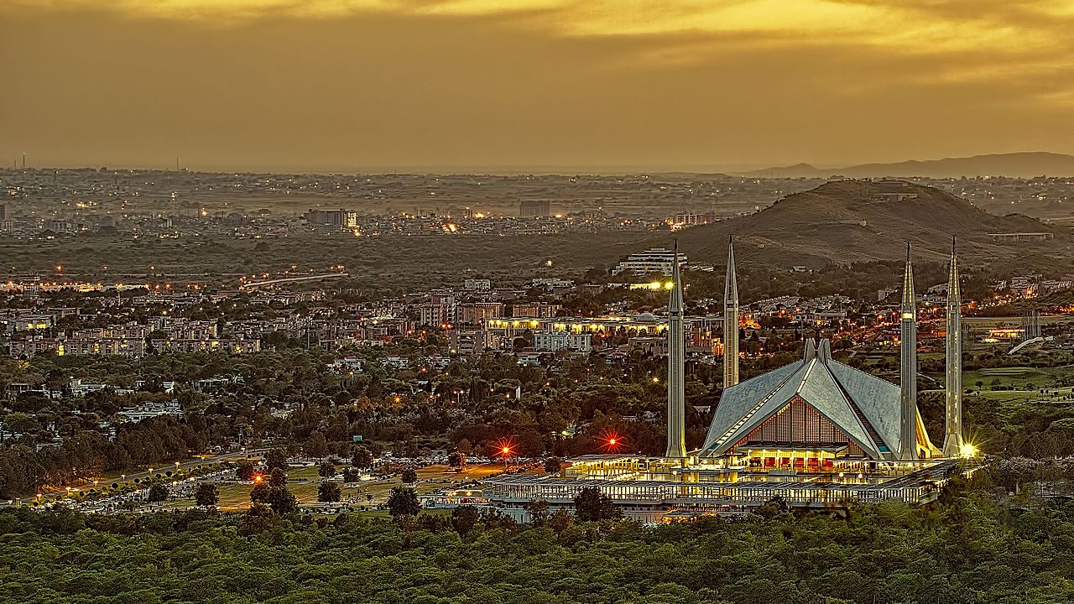
Section 1
Temperature Variations
In Pakistan
Mean Temperature Comparison of Different Areas
<Your Name>
<Date>

Slide 5
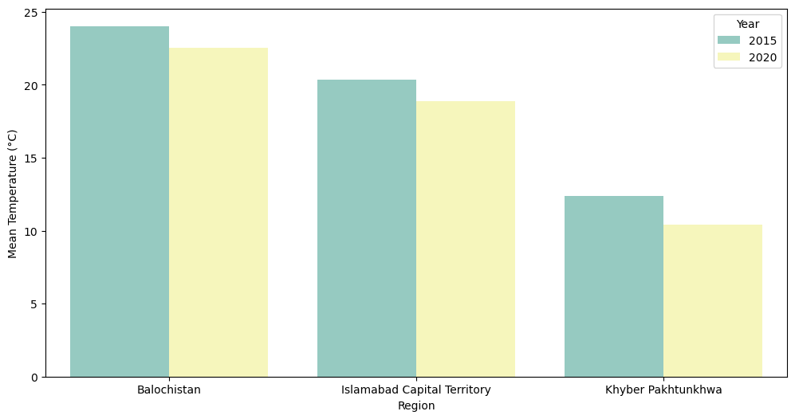
Comparison of Different Areas 1/2

Slide 6
Comparison of Different Areas 2/2
This graphs shows the comparison of Balochistan, KPK and Islamabad and it compares them by their mean temperature. Two specific years have been chosen in this case, 2015 and 2020.
As we can see, Balochistan has the greatest mean temperature, followed by Islamabad and then KPK. It is also interesting to see that the mean temperature for all 3 areas has dropped when we compare 2015 to 2020.
Balochistan and Islamabad see almost identical fall in temperature, whereas KPK sees the greatest change in the mean temperature.

Slide 7
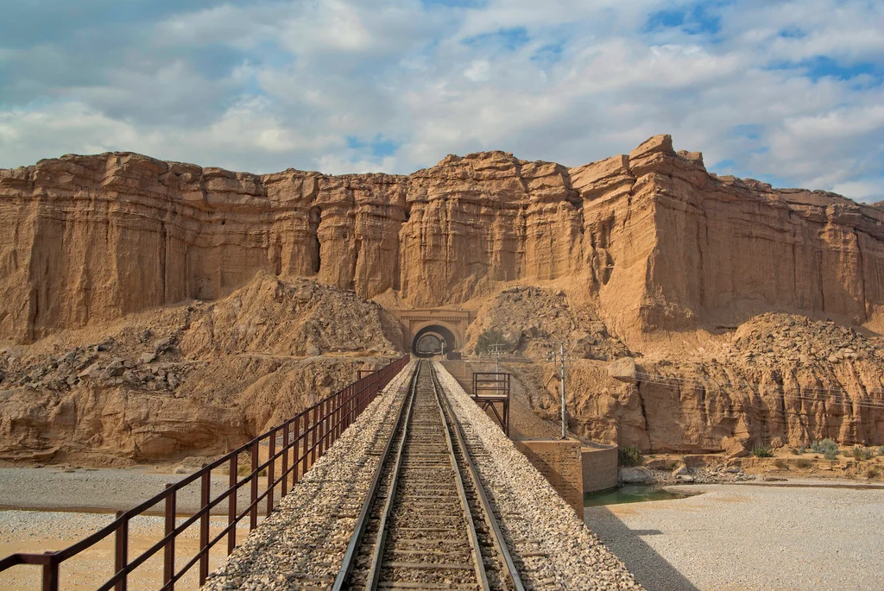
Section 2
Mean Temperature of Pakistan Throughout the Years

Slide 8
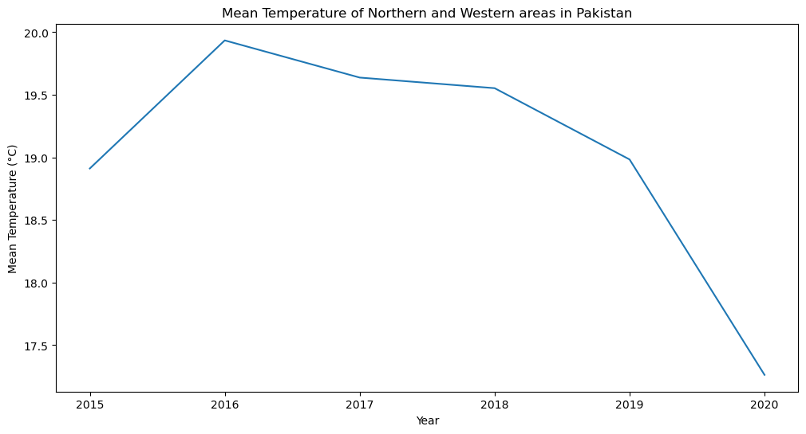
Pakistan’s Temperature Throughout The Years 1/2

Slide 9
Pakistan’s Temperature Throughout The Years 2/2
This graphs shows the overall temperature change in the Northern, North-Eastern and Eastern Areas of Pakistan from the years 2015 to 2020
We can see that the mean temperature increases from 2015 to 2016, and it peaks at 2016. However, from that point on, we can only see the decrease in these temperatures.
We observe a steep decline in the mean temperature from 2019 to 2020. 2020 records the lowest temperature in this time range, far less as compared to the other years.

Slide 10
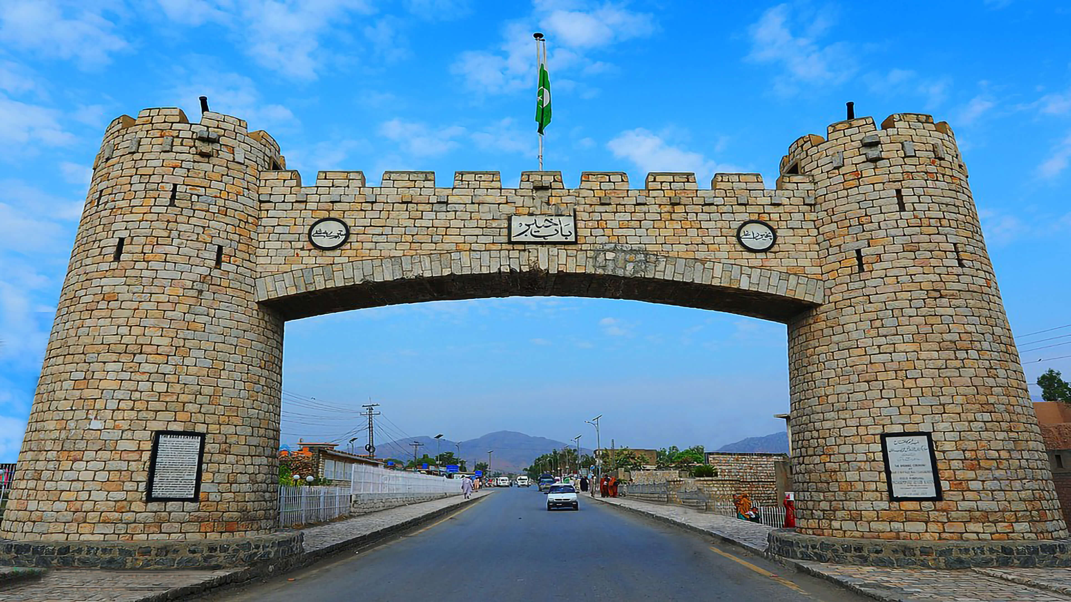
Section 3
Mean Temperature Comparison of Areas Throughout the Years

Slide 11
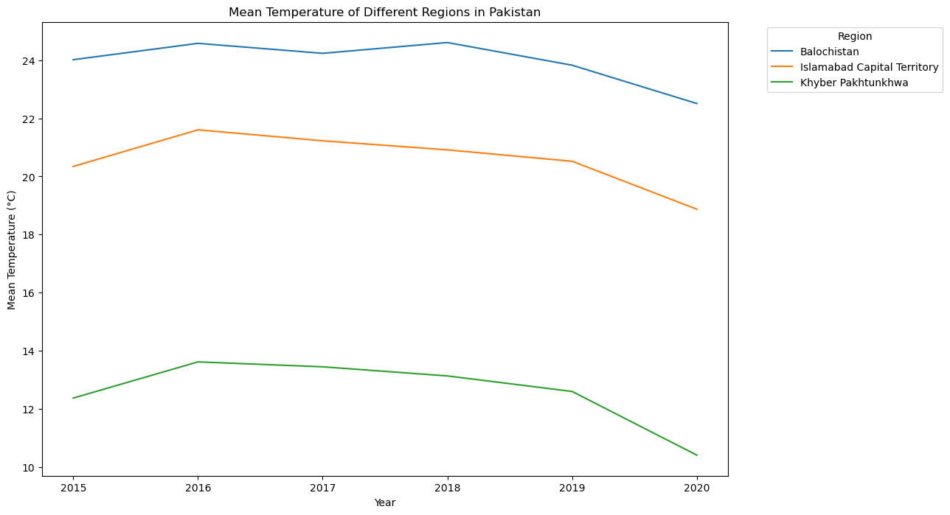
Temp. Comparison Throughout The Years 1/2

Slide 12
Temp. Comparison Throughout The Years 2/2
This graphs shows the mean temperature change in the Balochistan, KPK and Islamabad from the years 2015 to 2020. KPK records the lowest temperature in all years while Balochistan reports the highest.
We can notice that they follow almost the same pattern in terms of mean temperature. Their temperature peaks in 2016, and drops to the lowest in 2020, except for Balochistan, whose mean temperature peaks in 2018

Slide 13

Section 4
Key Findings and Conclusion

Slide 14
Key Findings and Conclusions
From the observations we made, we can see that the overall temperature of these Pakistani Areas has been decreasing, showing the greatest decrease from 2019 to 2020. This could be because of the reduced carbon emissions from vehicles because of Covid-19 Lockdown, and other factors may contribute as well.
KPK has been extravagantly the coldest area among these constantly from 2015 to 2020. This could be attributed to the fact that KPK has the highest altitude as compared to the other areas. On the opposite end, Balochistan has the highest temperature in this time frame, mainly because it’s a dry region, hence it records high summer temperatures.
The mean temperature peaks in 2016, making it the hottest year in this range, and the coldest year in this range is 2020 as the mean temperature is the lowest in that year.

